Slide 1










E-Commerce Supply Chains
Presenter's Name: Mayar Hany Rafik
Fatma Mohamed Eldamaty
Hana Raafat abd El Hemeed
Habiba Abel Ahmed
1
16\5\2025

Slide 2


Project Idea:E-Commerce Supply Chains
Brief Description of the Problem Being Solved:
-In the fast-paced world of e-commerce, delayed shipments negatively impact customer satisfaction and profitability. A significant number of orders fail to arrive on time, which can lead to reduced customer loyalty and lost revenue.
Unique Value Proposition:
-What sets our project apart is the integration of advanced data analysis techniques with interactive dashboards using Power BI. This enables stakeholders to not only understand the causes of delivery issues but also make data-driven decisions to improve operational efficiency and customer experience.
16\5\2025
2

Slide 3
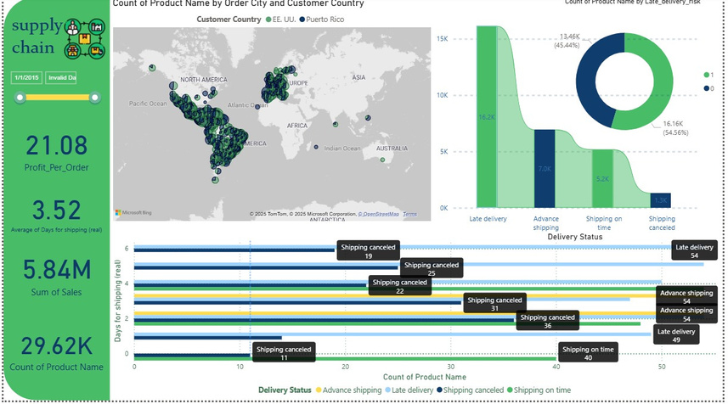



Visual Overview of the Dashboard Structure
The project dashboard is designed in Power BI and structured into five main pages:
1\verview – Summarizes key KPIs like total orders, on time vs late deliveries, and profit margins.
2\ Orders Analysis – Deep dive into delivery performance across cities, states, and shipping modes.
3\Customer Analysis – Explores customer segments, regions, and average sales per customer.
4\ Profit Analysis – Tracks profitability by category, product, and evaluates impact of delays.
5\Discounts Analysis – Assesses how discounts influence overall revenue and order profit.
16\5\2025
3

Slide 4
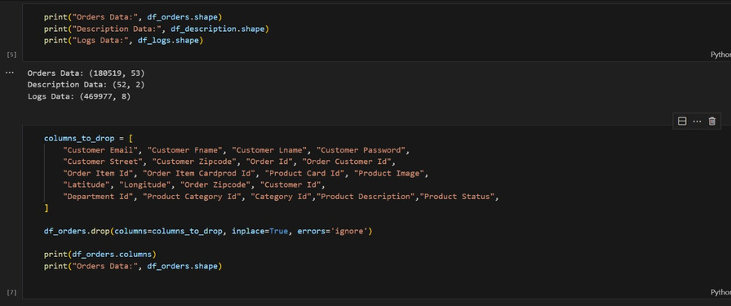


The code begins by importing essential libraries for data analysis and visualization, followed by loading supply chain data from CSV files into DataFrames. It then cleans the data by removing unnecessary columns, checking for missing values, and eliminating duplicates. Date columns for orders and shipping are converted to the datetime data type, and the cleaned data is saved into new CSV files. Finally, interactive dashboards are created to analyze performance metrics, including total orders, delivery status, and average shipping days, with customized colors and layout for enhanced visual appeal
4
16\5\2025

Slide 5

Key Features That Address User Needs
Delivery Delay Analysis: Highlights areas, shipping modes, and product types with most delays.
Customer Segmentation: Breaks down customer data by location, segment, and sales activity.
Profitability Insights: Analyzes profit per order, discount impact, and top-performing products.
16\5\2024
5

Slide 6
Data Structure:
The dataset used in this project is a structured CSV file containing over 10,000 records and more than 30 features. It follows a relational-style format, where each order is linked to a customer, product, region, and shipping mode. Key attributes include delivery status, scheduled vs. actual shipping days, discount rates, and profit ratios. The data was preprocessed and analyzed using Python (Pandas) to calculate shipping delays and financial metrics. The cleaned data was then imported into Power BI to build an interactive dashboard. The dataset is partially imbalanced, with delays more concentrated in specific regions and product types, which made the analysis both challenging and insightful.
6
16\5\2025

Slide 7
Programming Languages + Frameworks
The main programming language used in this project is Python, which was utilized for data cleaning, preprocessing, and analysis using libraries such as Pandas, NumPy, and Seaborn. For data visualization, Power BI was employed to create interactive dashboards and extract insights from the cleaned dataset. While no backend frameworks or APIs were required, the project demonstrates effective use of data analytics tools to explore delivery performance and operational efficiency within a supply chain context.
16\5\2025
7

Slide 8
Deliverables:
The final deliverables of this project include a comprehensive Power BI dashboard that visualizes key metrics related to delivery performance, customer behavior, and profitability. In addition, a technical report will be provided detailing the data analysis process, methodology, and key insights. The deliverables also include the cleaned dataset, Python code used for preprocessing, and presentation materials. All components were completed according to the project timeline, with major milestones including data preparation, dashboard development, and final documentation.
8
16\5\2025

Slide 9
Project Team:
The project was a collaborative effort by the entire team, where all members equally contributed to each stage of the work. Together, we handled data cleaning, analysis, dashboard design, and report writing. Our team members include: Mayar Hany Rafik, Fatma Mohamed Eldamaty, Hana Raafat Abd El Hemeed, and Habiba Abel Ahmed. We worked collectively on every task and maintained effective communication through shared documents and regular discussions. This collaborative approach helped us stay aligned, boosted our productivity, and ensured that everyone’s ideas were heard and valued—making the overall team experience more successful and enriching.
16\5\2025
9

Slide 10
Thank You
16\5\2025
10

